Slide 1

K. J. Somaiya Institute of Technology, Mumbai
Department of Computer Engineering A.Y. 2024-25
Transforming Landscapes: Potential Impact of Land Use Land Cover (LULC) on Air Quality
Supervisor:
Dr. Jyoti Wadmare
LY-A
Kapil Bhatia – 29 Palak Desai – 37
Dakshita Kolte – 59

Slide 2

ABSTRACT
This research examines the integration of LULC classification with air quality analysis using remote sensing data and EO methods. This study therefore evaluates the possible effects of various LULC patterns in urban as well as rural areas. Land use and cover are regarded as the main factors influencing the actual emissions and dispersion of pollutants, which further affect the overall quality of the air in a region. Utilizing the satellite images provided by Google Earth Engine (GEE), we classify high-resolution LULC maps representing urban sprawl, vegetation cover, aquatic bodies, and industrial areas, all with variable impacts on air quality. Concurrent monitoring of LULC data with air quality data, such as SO₂, NO₂, PM₁₀ and PM_{2.5}, is used to understand how changes in the land-use pattern, especially urbanization and deforestation, affect variances in air pollution level. Through the use of machine learning techniques, work allows the prediction of the spatial distribution of air pollutants using LULC traits to identify high-risk locations that are prone to air quality degradation. The results of this study show that comprehensive sustainable land management practices are required to help alleviate the problem of air pollution. Moreover, the research highlights the need for EO technology to deliver prompt and dependable data to policy-makers and city planners, as well as environmental scientists to set up effective plans to enhance the quality of air. This paper hopes to add to the growing collection of literature on how land use affects the environment and sets urban air quality.

Slide 3
PROBLEM DEFINITION
Land use land cover classification is an essential tool to manage the environment and provide information about urban planning, spatial distribution of land cover types and human land use patterns including urban areas, agricultural land, forests, water bodies, and barren land.
Examining these classifications allows us to better comprehend the complex interaction between land use, human activity, and environmental activity, particularly air quality.
LULC enables the mapping and monitoring of land use and land cover changes across time, highlighting the importance of tracking land cover changes with satellite and remote sensing data.

Slide 4
AIM AND OBJECTIVES:
Collect and prepare a dataset, classify specific land cover types and their impact on air quality, and create a custom dashboard for visualization.
Build a machine learning model based on land use land cover classification to predict future air quality changes.
Evaluate the performance and future predictions of the developed custom machine learning model to assess its impact on air quality.

Slide 5
LITERATURE SURVEY
Reference No. | Our Understanding | Methodology Used | Dataset Used | Gaps in Existing System
[1] | Investigates LULC changes on air quality in Gujarat using satellite data and Google Earth Engine. Highlights need for advanced technologies. | Acquire and preprocess Sentinel-2 tiles, create training/testing samples, implement sampling strategies, train and evaluate classifiers, and assess accuracy. | Sentinel-5P MODIS Landsat-8 | Limited geographic coverage, outdated techniques
[2] | Collect remote sensing and GIS data, apply CA-Markov model for LULC predictions, create thematic maps, analyze transitions and probabilities, and validate with Kappa Index. | Collect Landsat data (2010, 2020), create LULC maps with ArcGIS, apply CA-Markov model for future scenarios (2030-2100), use transition matrices and probability vectors for predictions. | Landsat-ETM+ based 2010 and Landsat-OLI based 2020 data | Dependency on historical data, limited socio-economic factors
[3] | Investigates LULC changes in Zambia using CA-Markov model. Highlights need for advanced models and addressing data scarcity. | Collect remote sensing and GIS data, apply CA-Markov model for LULC predictions, create thematic maps, analyze transitions and probabilities, and validate with Kappa Index. | ESA CCI land cover maps from 2000, 2010, and 2020 | Insufficient dataset integration, need for advanced algorithms
[4] | Addresses LULC mapping in Sudan using Google Earth Engine and CA-ANN model. Emphasizes impact of human activities on LULC changes. | Collect Landsat imagery, classify with Random Forest in Google Earth Engine, analyze LULC changes, and predict future trends using the CA-ANN model. | LULC maps for 2000, 2010, and 2020 provided by Copernicus Climate Data Store | Inconsistent LULC mapping standards, lack of automation

Slide 6
LITERATURE SURVEY
Reference No. | Our Understanding | Methodology Used | Dataset Used | Gaps in Existing System
[5] | Examines LULC changes in Wabe-Shebele river basin using CA-Markov model. Emphasizes need for sustainable land management. | Collect remote sensing and GIS data, apply CA-Markov model, analyze with GIS and image processing, and validate with Kappa indices. | Landsat TM for 1992 Landsat ETM+ for 2007 Landsat-8 OLI for 2022 | Inconsistent LULC mapping standards, lack of automation
[6] | Investigates LULC changes in Thimphu using CA-Markov model. Highlights need for improved policy frameworks. | Collect historical LULC data and field observations, apply CA-Markov model for simulation and prediction, and validate with Kappa indices. | Landsat 7 and 8 | Limited integration of socio-economic factors, need for high-resolution data
[7] | Analyzes machine learning models to predict PM10 levels in Sri Lanka. Highlights need for robust models and efficient hyperparameter optimization. | Data collection and cleaning, correlation analysis, data scaling using MinMax Scaler, selection and training of various machine learning models, hyperparameter tuning, performance evaluation using multiple indices. | Hourly data (1/1/2019 - 31/5/2021) for Battaramulla and Kandy, Sri Lanka: temperature, humidity, solar radiation, rainfall, wind speed/direction, and O3, CO, NO2, SO2, PM2.5, PM10 concentrations. | Insufficient dataset integration, need for advanced algorithms

Slide 7
LITERATURE SURVEY
Reference No. | Our Understanding | Methodology Used | Dataset Used | Gaps in Existing System
[8] | Evaluates sampling designs' impact on machine learning classifiers for LULC classification using Sentinel-2 data. Emphasizes the importance of sampling strategies. | Collect remote sensing and GIS data, apply CA-Markov model, analyze with GIS and image processing, and validate with Kappa indices. | Sentinel-2 data (10m spatial resolution) Study area: Dehradun district, Uttarakhand, India Data acquired on 12 January 2021 | Lack of comprehensive evaluation of sampling designs' impact on classifier performance
[9] | Assesses impact of LULC changes on evapotranspiration in Maharashtra using Google Earth Engine and CART model. Highlights need for high-resolution data and accuracy. | Collect historical LULC data and field observations, apply CA-Markov model for simulation and prediction, and validate with Kappa indices. | Landsat-8 OLI images for the winter seasons from 2018 to 2022 in Akola Block, Maharashtra, India. | Insufficient temporal resolution, inadequate spatial accuracy
[10] | The paper studies Mathura, India (1990-2020) using Landsat images and GIS. It finds increased urban and agricultural areas, decreased water bodies, and reduced forest cover, highlighting the need for better land management. | The methodology includes pre-processing the images, classifying LULC using Random Forest, and analyzing changes with GIS. | Landsat-5, 7, and 8 OLI (USGS) images | Better dataset pre-processing, reduced processing power, overcoming weather impacts, simplifying complex methods, and addressing errors from dynamic environments.

Slide 8
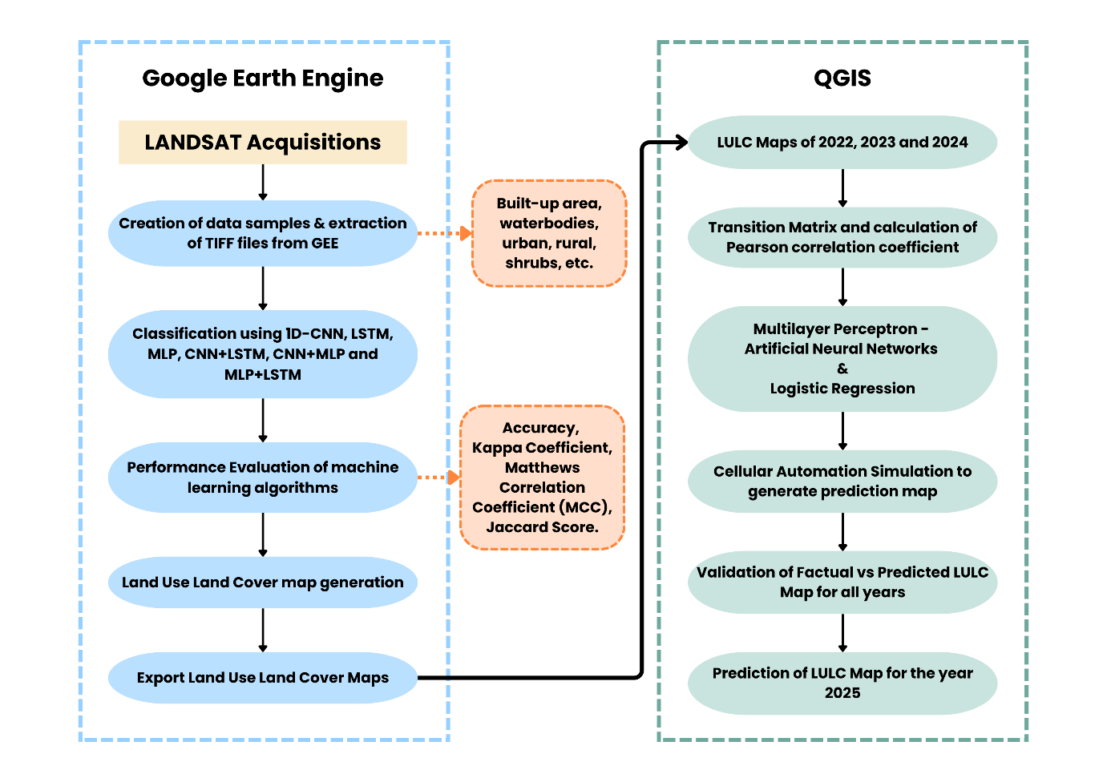
METHODOLOGY
Figure 1: Proposed Methodology of the study

Slide 9
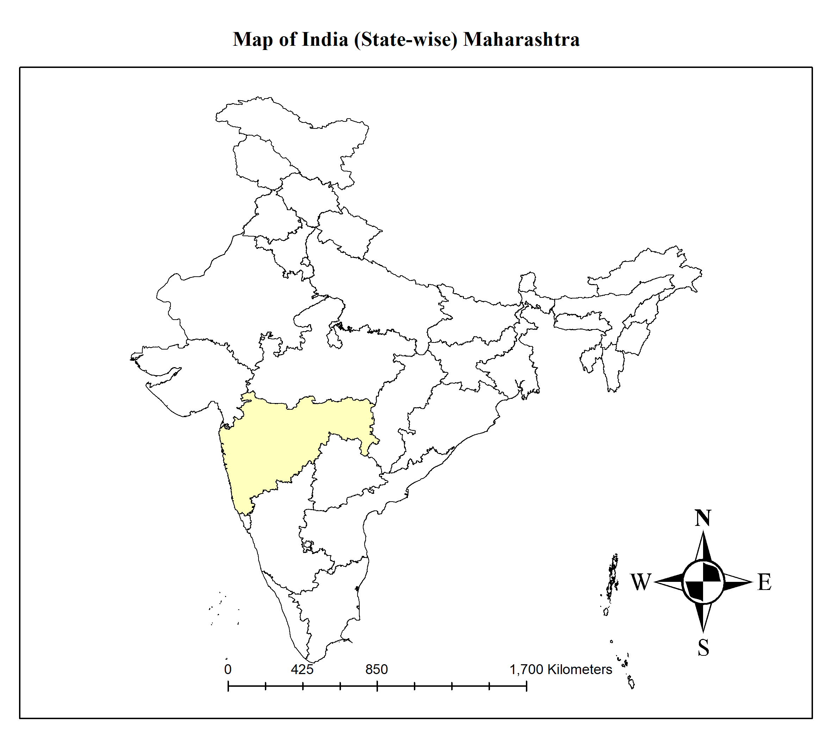
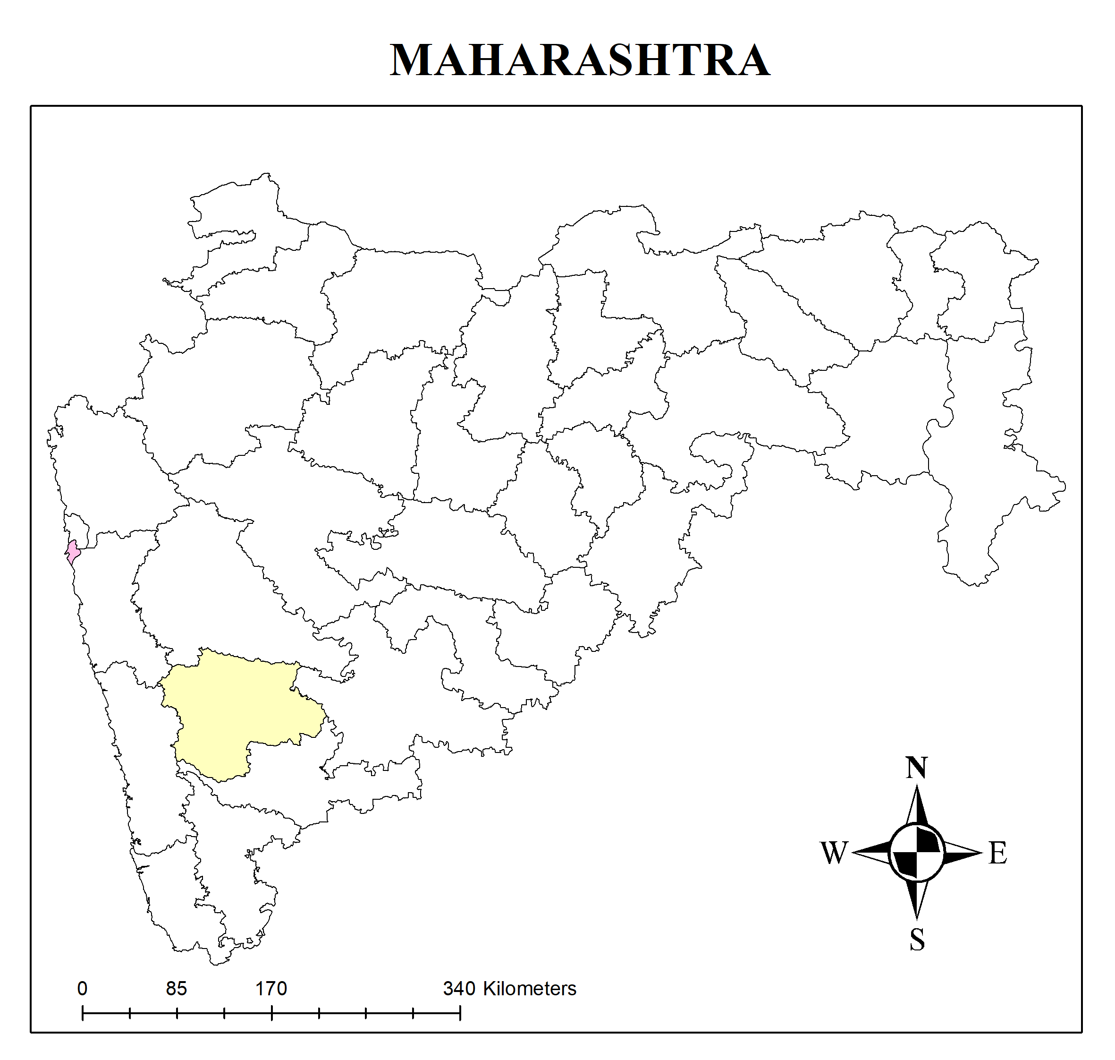
METHODOLOGY
Figure 2: Map of India
Figure 3: Map of Maharashtra

Slide 10
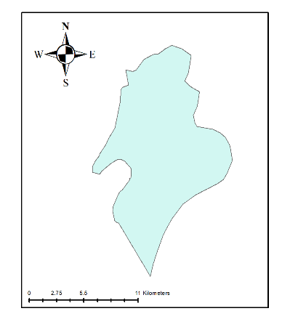
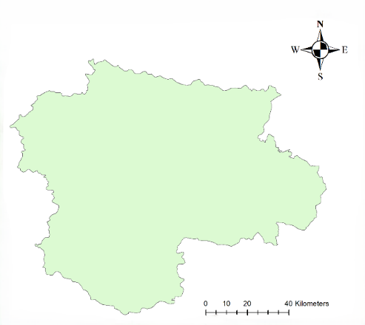
METHODOLOGY
Figure 4: Map of Mumbai
Figure 5: Map of Satara

Slide 11
METHODOLOGY
Data Sources:
Landsat 8 and Landsat 9 satellite imagery for LULC classification and future change analysis (see Table 2).
Google Earth Engine (GEE) used for data collection for both Mumbai and Satara.
Parameter | Landsat 8 and Landsat 9 Satellite
Cloud Platform | Google Earth Engine (GEE)
Satellite | Landsat 8, Landsat 9
Sensor | Operational Land Imager (OLI) and Thermal Infrared Sensor (TIRS)
Product Type | Surface Reflectance
Sensor Operational Modes | Multispectral and Thermal
Polarizations | Not applicable (optical sensor)
Orbit Properties Pass | Ascending and Descending
Image Acquisition Date | Based on available dates with <10% cloud cover
Cloud Cover | Less than 10% (filtered for clear-sky conditions)
SENSING_TIME | Specific timestamp for each image acquisition
LANDSAT_PRODUCT_ID | Unique identifier for Landsat product version
Table 1: Landsat Satellite Information

Slide 12
SYSTEM IMPLEMENTATION
Step 1: Acquiring Dataset for Land Use Land Cover Classification
District (Mumbai) | Built | Water | Wetland | Herbaceous | Dry Shrubs | Palm oil | Wet Shrubs | Bare land | Plantation Forest
Geometrical Points | 97 | 30 | 52 | 32 | 28 | 26 | 42 | 34 | 30
Table 2: Number of Datapoints for Mumbai region
District (Satara) | Built | Water | Wetland | Herbaceous | Dry Shrubs | Palm oil | Wet Shrubs | Bare land | Plantation Forest
Geometrical Points | 67 | 45 | 18 | 15 | 9 | 1 | 19 | 23 | 51
Table 3: Number of Datapoints for Satara region

Slide 13
SYSTEM IMPLEMENTATION
Step 2: Model Training and Evaluation
The CSV and TIF file of Mumbai and Satara region, acquired from the Landsat dataset, is used for training the model.
B1 | B2 | B3 | B4 | B5 | B6 | B7 | EVI | NBR | NDMI | NDWI | NDBI | NDBaI | elevation | classvalue | sample
0.068043 | 0.080555 | 0.105882 | 0.120623 | 0.201638 | 0.190665 | 0.14826 | 0.153297 | 0.152552 | 0.027969 | -0.31138 | -0.02797 | 0.125116 | 5 | 1 | train
0.06587 | 0.078204 | 0.098898 | 0.106199 | 0.156716 | 0.178923 | 0.148838 | 0.104601 | 0.025785 | -0.06616 | -0.2262 | 0.066161 | 0.09179 | 8 | 1 | train
0.072621 | 0.084597 | 0.105044 | 0.11262 | 0.16014 | 0.19061 | 0.162203 | 0.098886 | -0.0064 | -0.08687 | -0.20777 | 0.086871 | 0.080517 | 11 | 1 | train
0.068304 | 0.081366 | 0.104893 | 0.110626 | 0.155713 | 0.180655 | 0.157569 | 0.093213 | -0.00593 | -0.07415 | -0.19501 | 0.074153 | 0.068257 | 11 | 1 | train
0.068593 | 0.08072 | 0.097495 | 0.102913 | 0.150735 | 0.17158 | 0.148164 | 0.102817 | 0.008602 | -0.06467 | -0.21448 | 0.064673 | 0.073234 | 10 | 1 | train
0.082067 | 0.093549 | 0.105058 | 0.113074 | 0.170879 | 0.203191 | 0.172886 | 0.125914 | -0.00584 | -0.08638 | -0.23854 | 0.086381 | 0.080582 | 10 | 1 | train
Table 3: CSV File

Slide 14
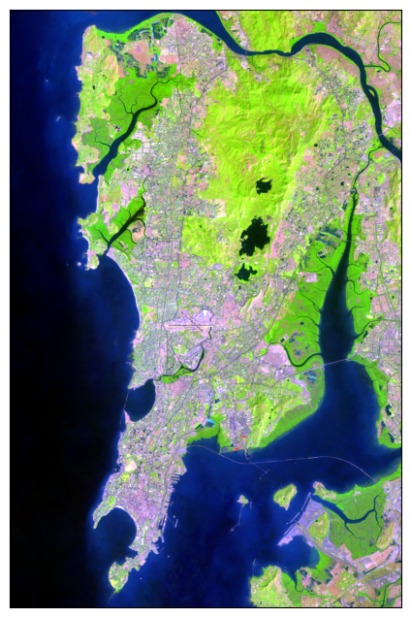
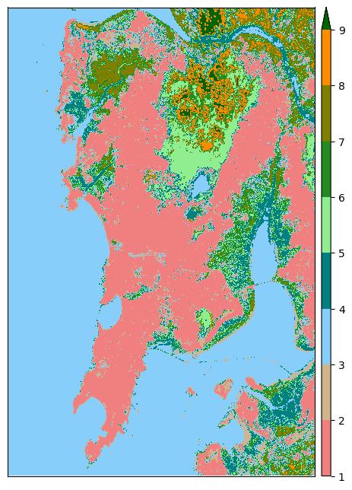

SYSTEM IMPLEMENTATION
Figure 6: Mumbai TIF files

Slide 15
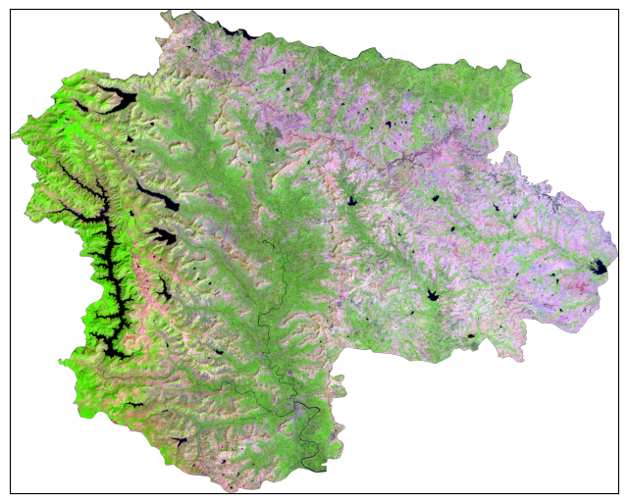
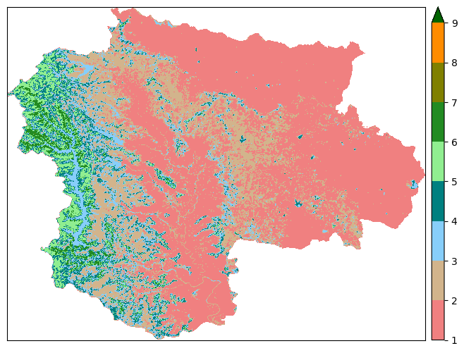
SYSTEM IMPLEMENTATION
Figure 7: Satara TIF files

Slide 16
SYSTEM IMPLEMENTATION
Step 3: Future Predictions
Classification Timeline:
LULC classification conducted for Mumbai for 2022, 2023, and 2024.
Models Used for Classification:
Machine Learning Models: 1D-CNN, MLP, LSTM.
Hybrid Models: CNN + LSTM, CNN + MLP, MLP + LSTM.
Analysis:
Changes in classification for each year analyzed to observe temporal changes across both regions.
Future Prediction:
LULC projection for 2025 performed using Molusce Tool in QGIS.
Future Prediction Models: ANN+MLP+LSTM, LR+MLP+ LSTM.
Click here to see the Mumbai LULC Classification
Click here to see the Mumbai LULC Future prediction
Click here to see the Satara LULC Classification
Click here to see the Satara LULC Future Prediction

Slide 17
SYSTEM IMPLEMENTATION
Year | Model | Accuracy (in %) | Kappa Coefficient | Matthews Correlation Coefficient (MCC) | Jaccard Score
2022 | 1D - CNN | 97.10 | 0.9546 | 0.9550 | 0.9537
 | MLP | 97.20 | 0.9562 | 0.9566 | 0.9539
 | LSTM | 98.07 | 0.9698 | 0.9698 | 0.9677
 | CNN+LSTM | 97.47 | 0.9603 | 0.9605 | 0.9569
 | CNN+MLP | 97.70 | 0.9641 | 0.9641 | 0.9614
 | MLP+LSTM | 98.17 | 0.9713 | 0.9714 | 0.9681
2023 | 1D - CNN | 97.79 | 0.9655 | 0.9657 | 0.9647
 | MLP | 97.15 | 0.9555 | 0.9560 | 0.9522
 | LSTM | 97.90 | 0.9672 | 0.9674 | 0.9634
 | CNN+LSTM | 97.23 | 0.9567 | 0.9569 | 0.9529
 | CNN+MLP | 96.95 | 0.9525 | 0.9526 | 0.9511
 | MLP+LSTM | 98.39 | 0.9748 | 0.9749 | 0.9716
2024 (Till 30th September 2024) | 1D - CNN | 95.12 | 0.9237 | 0.9254 | 0.9266
 | MLP | 96.87 | 0.9511 | 0.9519 | 0.9482
 | LSTM | 97.54 | 0.9616 | 0.9619 | 0.9601
 | CNN+LSTM | 97.12 | 0.9550 | 0.9552 | 0.9514
 | CNN+MLP | 96.62 | 0.9472 | 0.9473 | 0.9451
 | MLP+LSTM | 97.92 | 0.9674 | 0.9677 | 0.9631
Table 4: Performance Evaluation Metrics for Mumbai District

Slide 18
SYSTEM IMPLEMENTATION
YEAR | MODEL | KAPPA COEFFICIENT (IN %) | MATTHEWS CORRELATION COEFFICIENT (MCC) (IN %) | JACCARD SCORE (IN %)
2022 | 1D - CNN | 69.61 | 70.14 | 68.33
 | MLP | 71.69 | 72.27 | 70.33
 | LSTM | 67.97 | 68.44 | 67.38
 | CNN + LSTM | 68.75 | 68.95 | 67.50
 | CNN + MLP | 67 | 67.19 | 66.29
 | MLP + LSTM | 70.55 | 70.87 | 69.19
2023 | 1D - CNN | 70 | 70.61 | 68.99
 | MLP | 70.99 | 71.22 | 68.80
 | LSTM | 71.21 | 71.53 | 68.89
 | CNN + LSTM | 69.36 | 69.67 | 68.05
 | CNN + MLP | 68.33 | 68.52 | 66.89
 | MLP + LSTM | 66.76 | 67.07 | 65.17
2024 | 1D - CNN | 70.08 | 70.57 | 68.33
 | MLP | 71.73 | 72.19 | 69.70
 | LSTM | 73.73 | 73.91 | 71.01
 | CNN + LSTM | 68.20 | 68.39 | 67.02
 | CNN + MLP | 72.90 | 73.15 | 70.26
 | MLP + LSTM | 68.56 | 68.99 | 66.64
Table 4: Performance Evaluation Metrics for Satara District

Slide 19
CONCLUSION AND FUTURE SCOPE
Conclusion:
For Mumbai region, MLP + LSTM model gave the best results with Kappa coefficient as 96.74%, Mat-thew’s correlation coefficient as 96.77% and Jaccard score as 96.31% for years 2022, 2023 and 2024.
For Satara region, MLP model gave the best results with Kappa coefficient as 71.69%, Matthew’s correlation coefficient as 72.22% and Jaccard score as 70.33% for year 2022 and obtained Kappa coefficient as 70.99%, Matthew’s correlation coefficient as 71.22% and Jaccard score as 68.80% for year 2023. For year 2024, LSTM model performed the best with Kappa coefficient as 73.73%, Mat-thew’s correlation coefficient as 73.91% and Jaccard score as 71.01%.
Future Scope:
Model Optimization & Transfer Learning
High-Resolution Datasets
Integration with Policy Planning
Inclusion of Climate Variables

Slide 20
REFERENCES
[1] K. H. Jodhani et al., “Synergizing google earth engine and earth observations for potential impact of land use land cover on air quality,” Results in engineering, vol. 22, pp. 102039–102039, Jun. 2024, doi: https://doi.org/10.1016/j.rineng.2024.102039.
[2] Ajay Kumar Taloor, S. Sharma, Gurnam Parsad, and Rakesh Jasrotia, “Land use land cover simulation using integrated CA-Markov model in the Tawi Basin of Jammu and Kashmir India,” Geosystems and Geoenvironment, vol. 3, no. 2, pp. 100268–100268, May 2024, doi: https://doi.org/10.1016/j.geogeo.2024.100268.
[3] Chisanga, C.B., Phiri, D. & Mubanga, K.H. Multi-decade land cover/land use dynamics and future predictions for Zambia: 2000–2030. Discov Environ 2, 38 (2024). https://doi.org/10.1007/s44274-024-00066-w
[4] Osman MAA, Abdel-Rahman EM, Onono JO, Olaka LA, Elhag MM, Adan M, Tonnang HEZ. Mapping, intensities and future prediction of land use/land cover dynamics using google earth engine and CA- artificial neural network model. PLoS One. 2023 Jul 24;18(7):e0288694. doi: 10.1371/journal.pone.0288694. PMID: 37486922; PMCID: PMC10365312.
[5] S. Beshir, A. Moges, and Mihret Dananto, “Trend analysis, past dynamics and future prediction of land use and land cover change in upper Wabe-Shebele river basin,” Heliyon, vol. 9, no. 9, pp. e19128–e19128, Sep. 2023, doi: https://doi.org/10.1016/j.heliyon.2023.e19128.
‌
[6] S. W. Wang, L. Munkhnasan, and W.-K. Lee, “Land use and land cover change detection and prediction in Bhutan’s high altitude city of Thimphu, using cellular automata and Markov chain,” Environmental Challenges, vol. 2, p. 100017, Jan. 2021, doi: https://doi.org/10.1016/j.envc.2020.100017.
[7] L. Mampitiya, N. Rathnayake, Y. Hoshino, and U. Rathnayake, “Forecasting PM10 levels in Sri Lanka: A comparative analysis of machine learning models PM10,” Journal of Hazardous Materials Advances, vol. 13, p. 100395, Feb. 2024, doi: https://doi.org/10.1016/j.hazadv.2023.100395.
[8] Rawat, S., & Saini, R. (2023). Evaluating the impact of sampling designs on the performance of machine learning techniques for land use land cover classification using Sentinel-2 data. International Journal of Remote Sensing, 44(24), 7889–7908. https://doi.org/10.1080/01431161.2023.2290994
[9] Pande, C. B., Diwate, P., Orimoloye, I. R., Sidek, L. M., Pratap Mishra, A., Moharir, K. N., … Tolche, A. D. (2023). Impact of land use/land cover changes on evapotranspiration and model accuracy using Google Earth engine and classification and regression tree modeling. Geomatics, Natural Hazards and Risk, 15(1). https://doi.org/10.1080/19475705.2023.2290350
[10] Gupta P, Singh SK, Gupta P, Kanga S, Mishra VN. (2023) Application of Remote Sensing and GIS Techniques for Identification of Changes in Land Use and Land Cover (LULC): A Case Study. Indian Journal of Science and Technology. 16(46): 4456-4468. https://doi.org/10.17485/IJST/v16i46.2530

Slide 21
THANK YOU!!!

